Slide 3
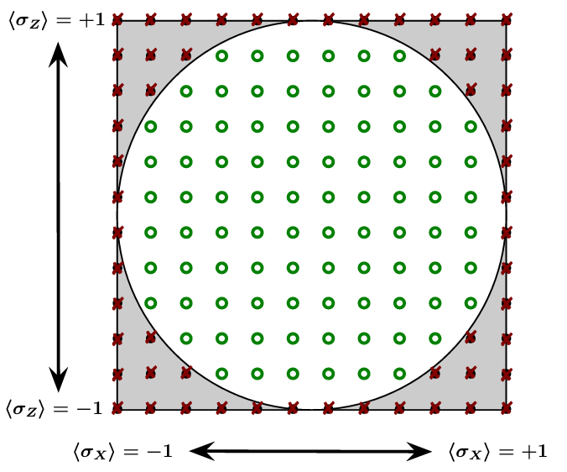
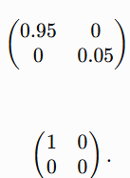
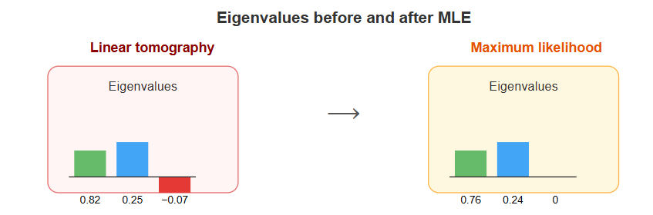
Why do we need other estimation techniques other than MLE
1. MLE maximizes the likelihood and can be rank deficient.
True eigenvalues of the density matrix:
MLE eigenvalues due to finite sampling
2. In MLE for special cases, convergence is not Guaranteed.
3. BME do come with error bars (uncertainty) of the estimate.

Slide 4




Bayesian Mean Estimation for Quantum State Tomography
1. Use the data to generate a likelihood function,
2. Choose a prior distribution over states. It represents the estimator’s ignorance, and should generally be chosen to be as ‘uniform’, or uninformative, as possible.
3. Multiply the prior by the likelihood and normalize to obtain a posterior distribution,
which represents the estimator’s knowledge. The proportionality constant is set by normalization.
4. Report the mean of this posterior,
This is the best concise description of the estimator’s knowledge.

Slide 5




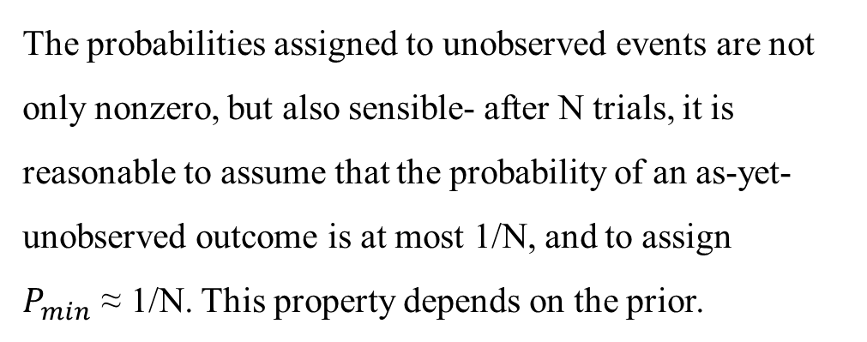
An Example of BME –
Coin flips (Bernoulli trials)
Heads: ‘b’
Tails: ‘(1-b)’
No. of Trials: ‘N’ with ‘n’ Heads
The probabilities assigned to unobserved events are not only nonzero, but also sensible- after N trials, it is reasonable to assume that the probability of an as-yet-unobserved outcome is at most 1/N, and to assign $P_{min}$ ≈ 1/N. This property depends on the prior.
Likelihood function
Initial estimator
Uniform Choice of Prior
Averaged over the Posterior

Slide 6
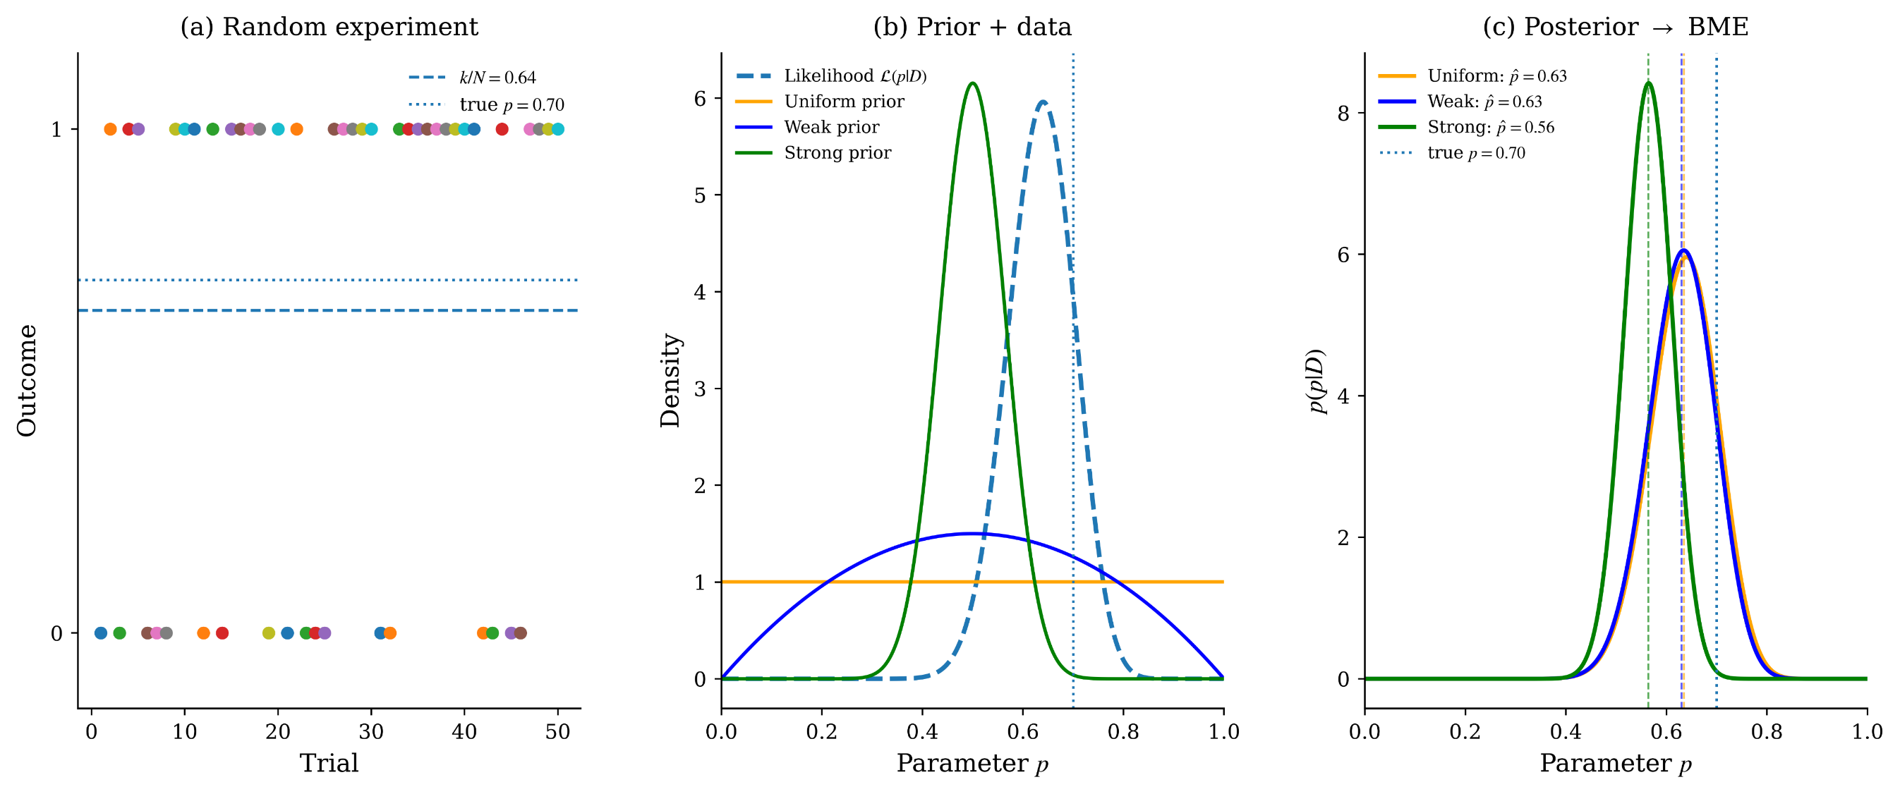
Estimating the Bernoulli parameter

Slide 7




The Metropolis-Hastings way of Integrating
It computes the average value of a distribution/function (in this case, $ρ$) over an integration measure.
It integrates by a simple jumping rule.
$ρ^{′}=J(ρ)$ where $J$ is the jump operator
Calculate this r-factor for consecutive $ρ^{′}s$
If r >1 (ρ′ is more likely than ρ), then we jump as before. If not, we jump to ρ′ with probability r, and stay at ρ (adding it, once again, to the running total) with probability 1−r.
This biasing ensures that the algorithm spends more time at more likely spots and tends to climb up into regions of high probability.
What is important is that J should generate the underlying measure dρ (uniform sampling in this case).

Slide 8
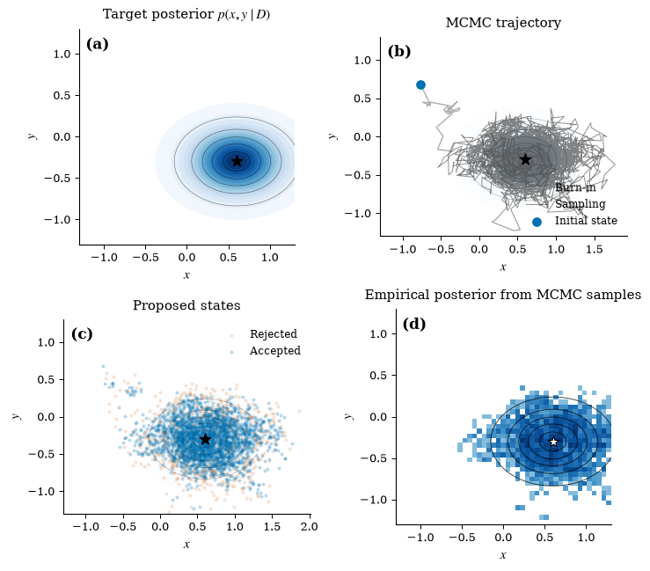
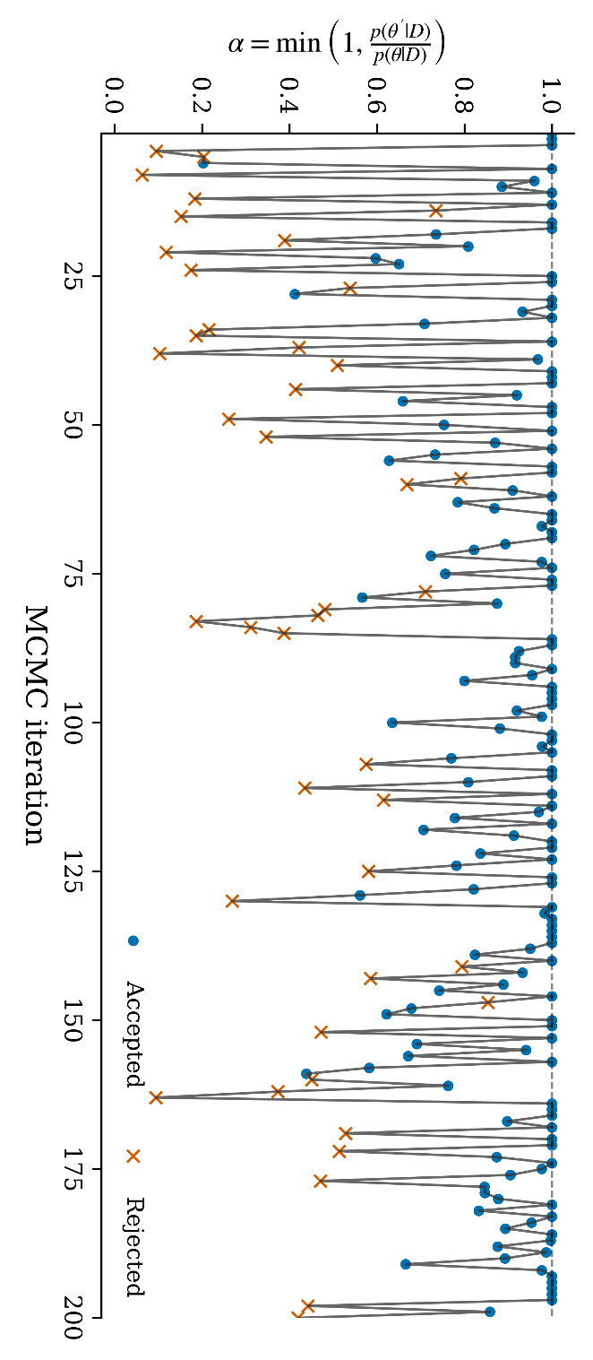

Slide 9
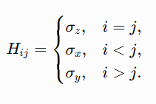



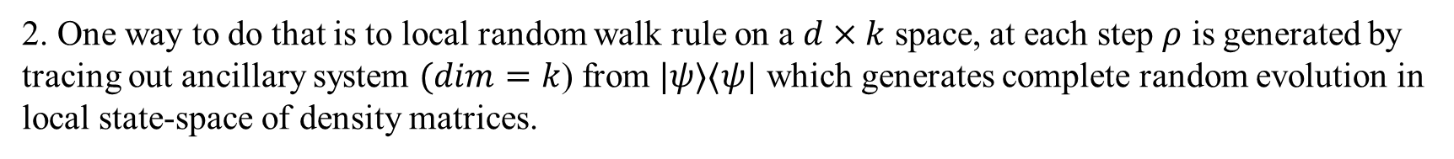
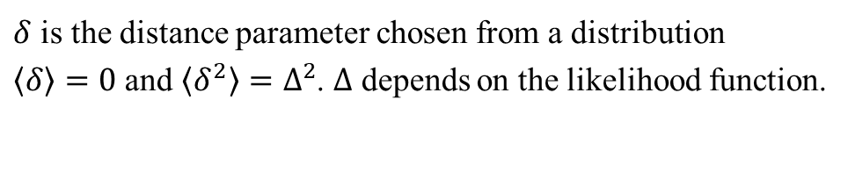
How do we Jump?
1 One way to do that is to generate random unitaries over Haar measure, generating random unitaries is computationally hard and it is only applicable for states with same purity. It doesn’t explore the full state-space.
2. One way to do that is to local random walk rule on a $d×k$ space, at each step $ρ$ is generated by tracing out ancillary system $(dim=k$) from $|ψ⟩⟨ψ|$ which generates complete random evolution in local state-space of density matrices.
$$(d×k)$$
$δ$ is the distance parameter chosen from a distribution
$⟨δ〉=0$ and $⟨δ^{2}〉=Δ^{2}$. $Δ$ depends on the likelihood function.
subspace
A good heuristic is $δ$should be chosen such that the acceptance ratio should be around 60%.

Slide 10
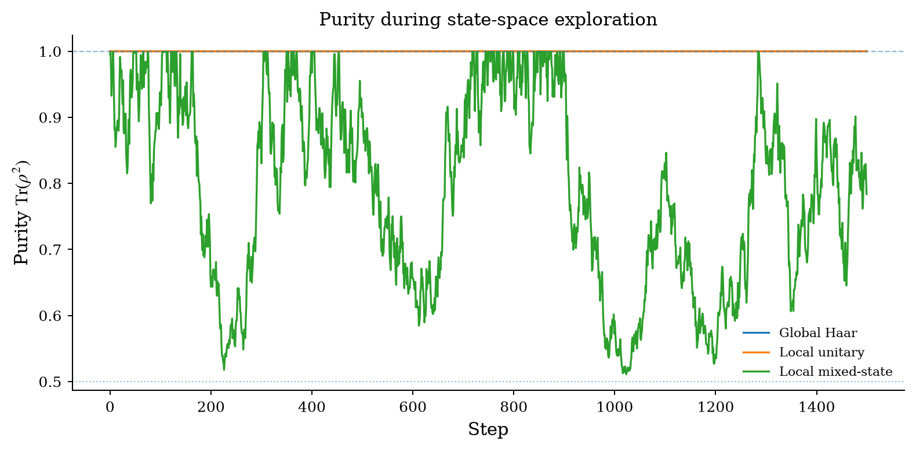
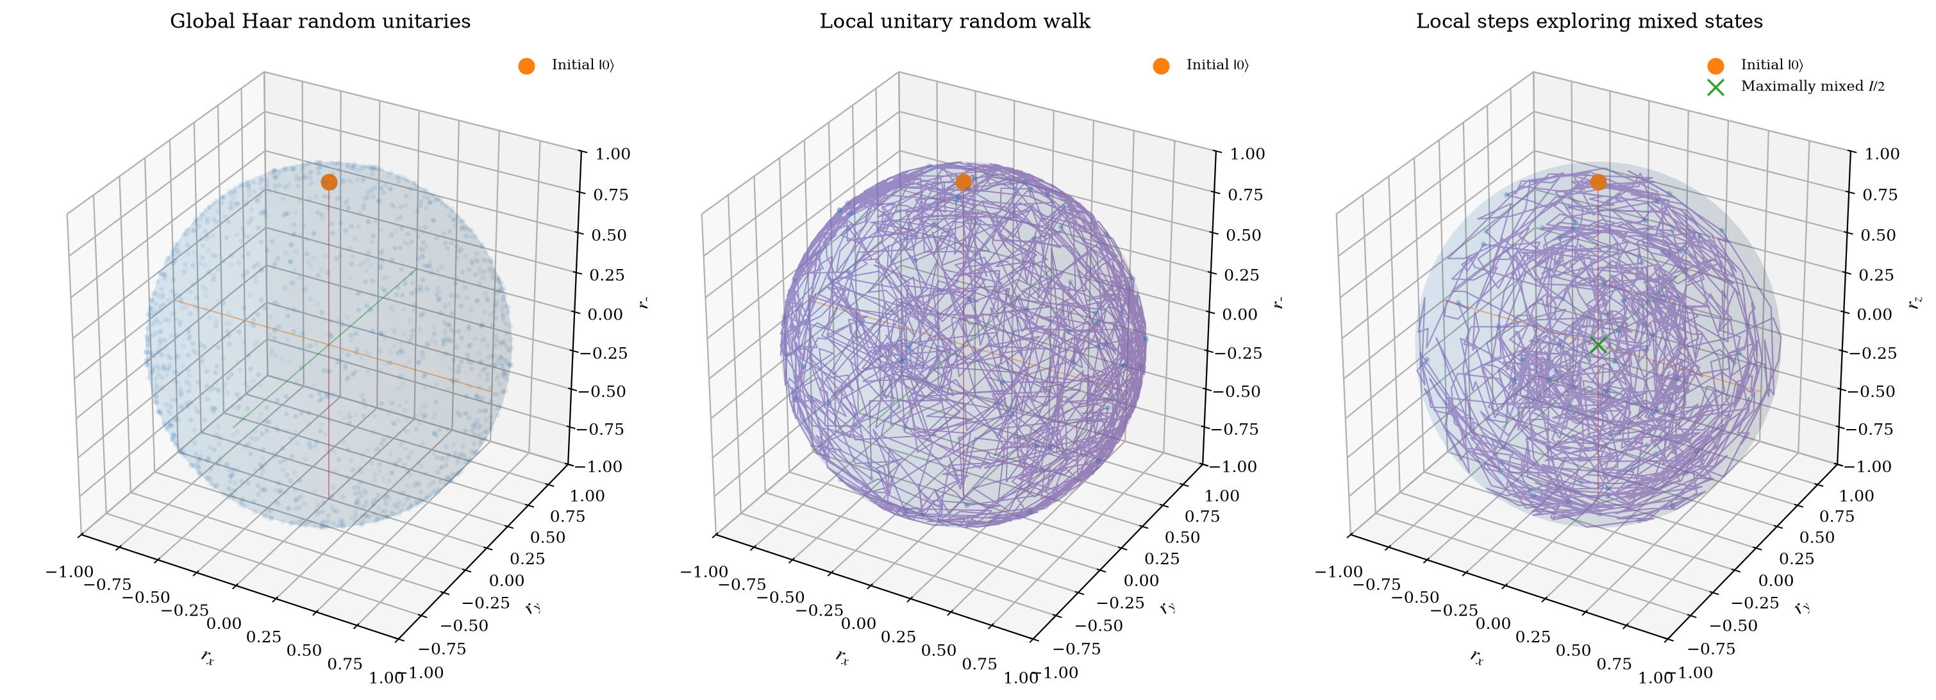
An Example for a single
qubit system

Slide 11
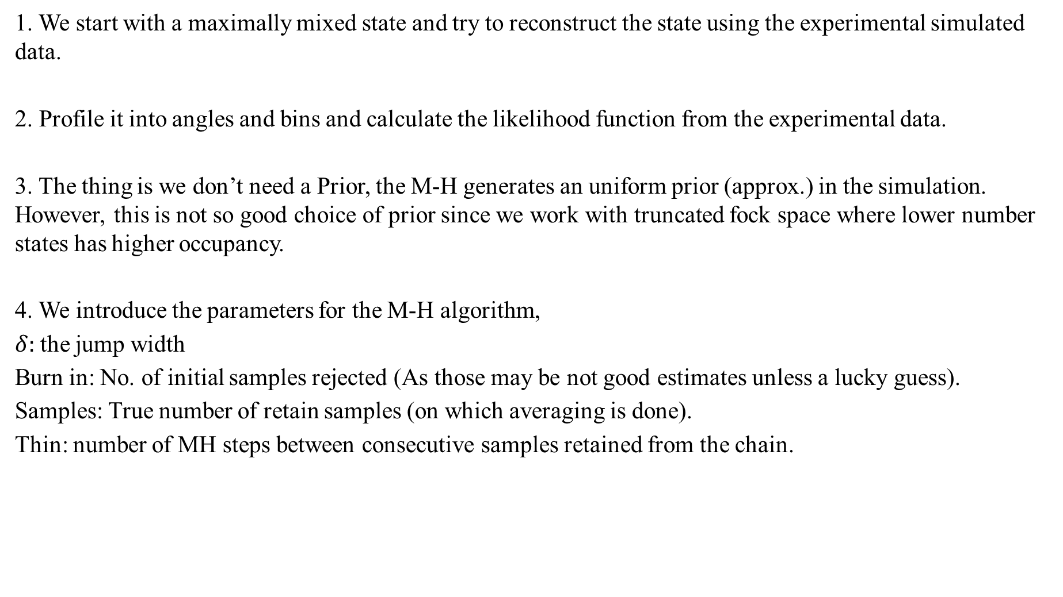
The Code is Messy-
1. We start with a maximally mixed state and try to reconstruct the state using the experimental simulated data.
2. Profile it into angles and bins and calculate the likelihood function from the experimental data.
3. The thing is we don’t need a Prior, the M-H generates an uniform prior (approx.) in the simulation. However, this is not so good choice of prior since we work with truncated fock space where lower number states has higher occupancy.
4. We introduce the parameters for the M-H algorithm,
$δ:$the jump width
Burn in: No. of initial samples rejected (As those may be not good estimates unless a lucky guess).
Samples: True number of retain samples (on which averaging is done).
Thin: number of MH steps between consecutive samples retained from the chain.

Slide 12
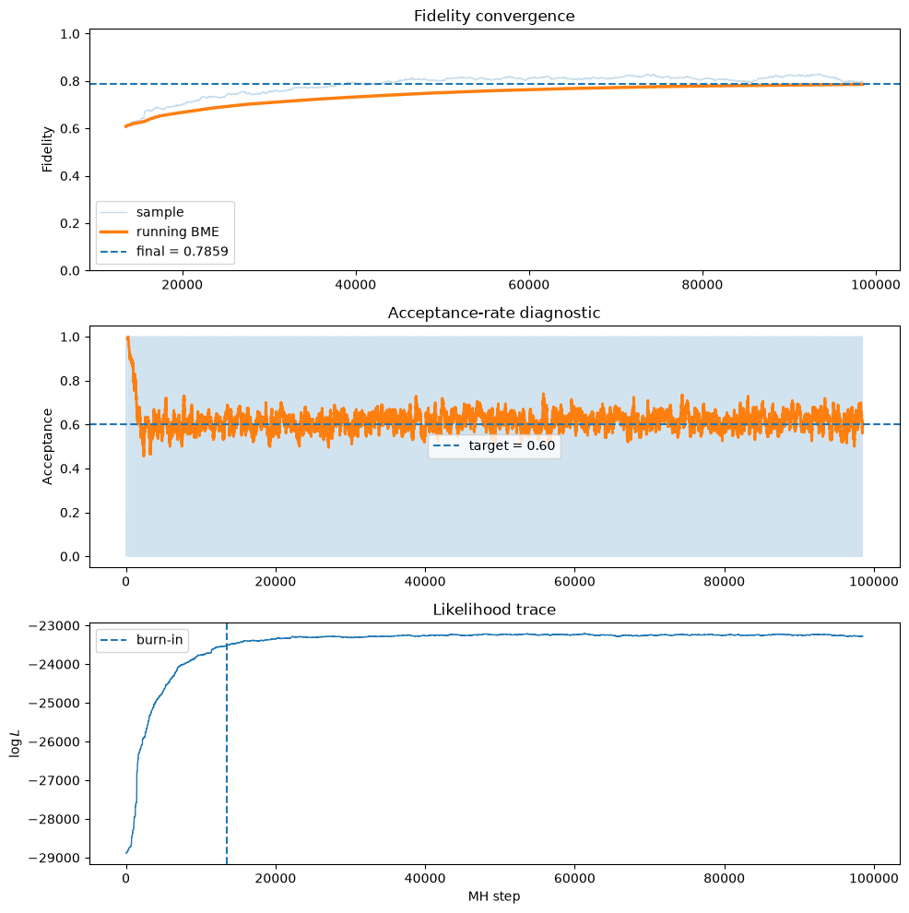
An Example of BME

